Slide 1


BIG DATA ANALYTICS LAB
REAL-TIME SOCIAL MEDIA TREND ANALYSIS USING PYSPARK
Arshiya Tarannum (23241A6703)
Srisha Koppula (23241A6736)
Under the guidance of Dr. M. Kiran Kumar & Ms. S. Srilatha | Dept. of CSE (Data Science) | GRIET, Hyderabad

Slide 2
PROBLEM STATEMENT:
Social media platforms generate massive amounts of real-time, unstructured data every second, reflecting user opinions, trends, and interactions. Analyzing this continuous stream of data to extract meaningful insights such as trending topics and public sentiment is challenging using traditional data processing methods. Existing approaches often fail to handle the high volume and velocity of data efficiently. Therefore, there is a need for a scalable and efficient system that can process, analyze, and provide real-time insights from social media data for better decision-making.

Slide 3
IMPACT:
• Enables real-time decision making through instant insights
• Helps understand public opinion and user sentiment
• Supports marketing, crisis detection, and analytics
• Improves business intelligence with data-driven insights
• Tracks trending topics and emerging patterns efficiently
OBJECTIVE
Build a scalable and efficient system using PySpark for big data processing
Perform real-time trend detection and sentiment analysis on social media data
Automate data collection, preprocessing, analysis, and visualization
Extract meaningful insights such as trending topics and public opinion

Slide 4
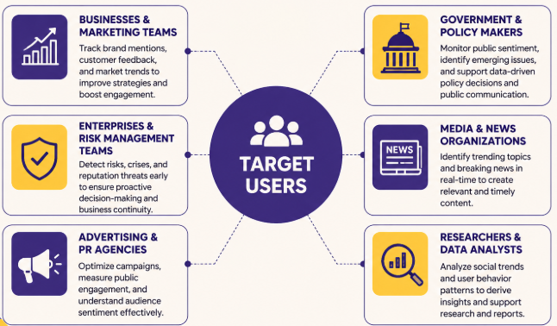
TARGET SEGMENT

Slide 5
WHY IS OUR SOLUTION ACCURATE?
Real-Time Processing with PySpark
The system leverages PySpark Structured Streaming to process continuously incoming social media data with minimal latency. It enables real-time ingestion, transformation, and analysis of high-velocity data streams. This ensures that trends and insights are generated instantly rather than after delays.
Efficient Data Preprocessing
Raw social media data is noisy and unstructured, so the system applies multiple preprocessing steps such as text cleaning, stopword removal, tokenization, and normalization.
Trend Detection
The system identifies trending topics by analyzing word frequency and hashtag occurrences in real time. It continuously updates trending keywords based on incoming data streams. .
Sentiment Analysis
Sentiment analysis is performed using NLP techniques to classify posts into positive, negative, or neutral categories.
Scalability
The system is built on Apache Spark, which supports distributed computing across multiple nodes. This allows it to handle large-scale data efficiently without performance degradation. As data volume increases, the system can scale horizontally to maintain speed and accuracy.

Slide 6
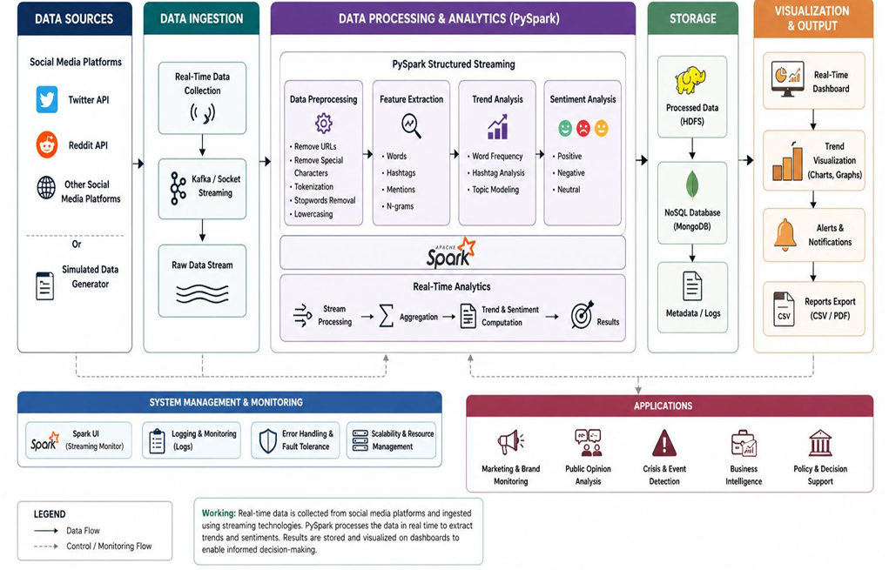
ARCHITECTURE DIAGRAM

Slide 7
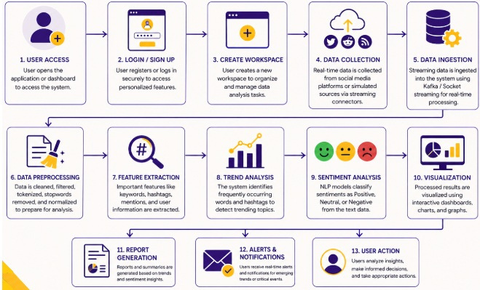
USER FLOW CHART

Slide 8
DEPLOYMENT COMPARISION
Component | AWS | GCP | Azure
Frontend | S3 + CloudFront | Cloud Storage + CDN | Blob Storage + CDN
Backend | Lambda / EC2 | Cloud Run / Functions | Azure Functions
Processing | EMR (Spark) | Dataproc | HDInsight
Streaming | Kinesis | Pub/Sub | Event Hubs
Database | DynamoDB | Firestore | Cosmos DB

Slide 9
CONCLUSION
What it is:
A real-time social media analytics system that processes large-scale streaming data using PySpark to identify trending topics, analyze public sentiment, and generate actionable insights for decision-making.
Key Features:
• Real-Time Data Processing: Continuous analysis of streaming social media data for instant insights.
• Trend Detection: Identification of trending topics and hashtags using frequency analysis.
• Sentiment Analysis: Classification of user opinions into positive, negative, and neutral categories.
• Scalable Architecture: Distributed processing using PySpark for handling large volumes of data efficiently.
• Data Visualization: Graphs and charts to present trends and insights clearly.

Slide 10
CONCLUSION
Benefits:
• Faster Decision-Making: Enables organizations to respond quickly to emerging trends and public opinions.
• Improved Business Intelligence: Provides meaningful insights from unstructured social media data.
• Automation: Reduces manual effort by automating data collection, processing, and analysis.
• Real-Time Monitoring: Helps track ongoing events, campaigns, and user engagement effectively.
Replicability:
• The system’s modular architecture allows easy adaptation across domains such as marketing, public opinion analysis, crisis management, and business intelligence by modifying data sources and analytical models.
Data Governance:
• Ensures secure handling of data through controlled access, proper data storage, and basic privacy measures. The system can be extended with advanced security features such as encryption, authentication, and compliance with data protection standards.

Slide 11
FUTURE ENHANCEMENTS
1. Advanced Machine Learning Integration
The current system uses basic sentiment analysis techniques, which can be enhanced using deep learning models such as LSTM, BERT, or transformer-based architectures. These models can better understand context, sarcasm, and complex language patterns, leading to higher accuracy.
2. Real-Time Interactive Dashboards
The visualization layer can be upgraded using tools like Power BI, Tableau, or web-based dashboards. This would allow users to interact with data, apply filters, and monitor trends dynamically in real time.
3. Multilingual Support
Social media data is highly diverse and multilingual. Extending the system to support multiple languages using advanced NLP techniques would make the system more globally applicable and improve inclusivity.

Slide 12
THANK
YOU

